Slide 1
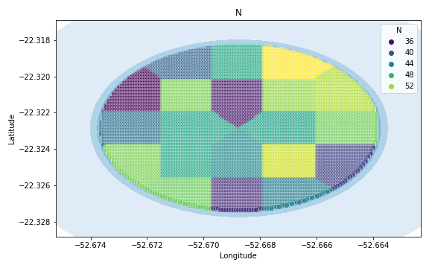
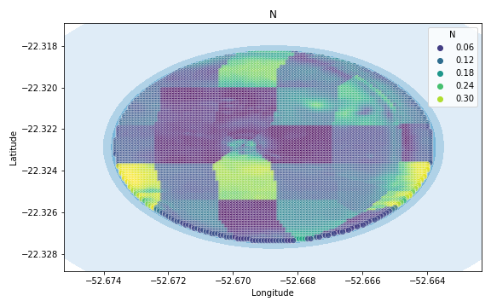
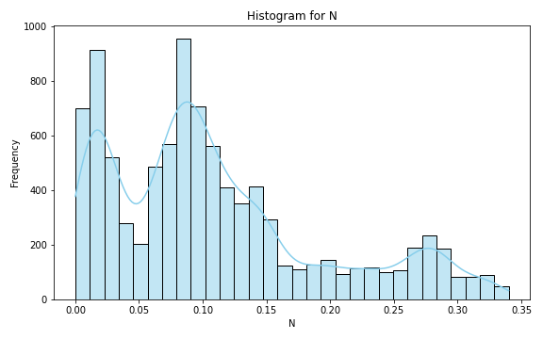
Analysis for column: N Model: Linear Regression
Statistics:
mean 0.109281
std 0.084150
min 0.000009
25% 0.040927
50% 0.091172
75% 0.145945
80% 0.166900
85% 0.210371
90% 0.260052
95% 0.284424
99% 0.323994

Slide 2
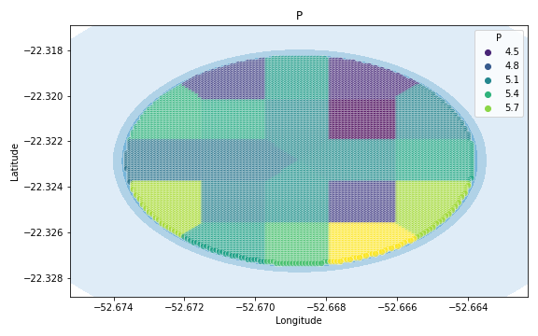
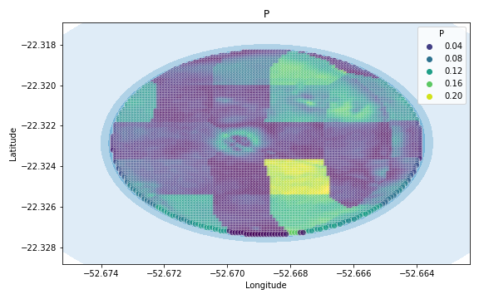
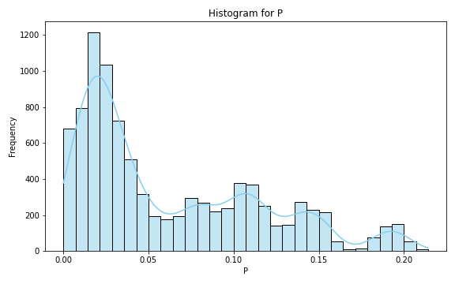
Analysis for column: P Model: Linear Regression
Statistics:
mean 0.062174
std 0.053232
min 0.000014
25% 0.019482
50% 0.038554
75% 0.103598
80% 0.111863
85% 0.125924
90% 0.142950
95% 0.159177
99% 0.198272

Slide 3
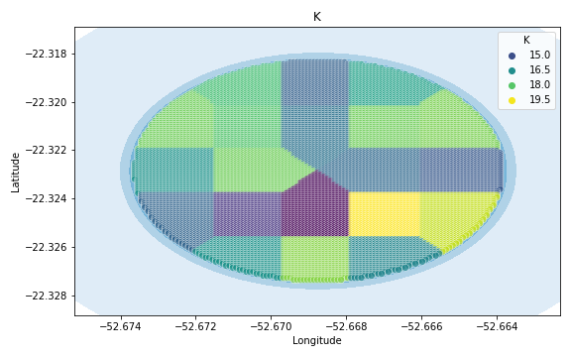
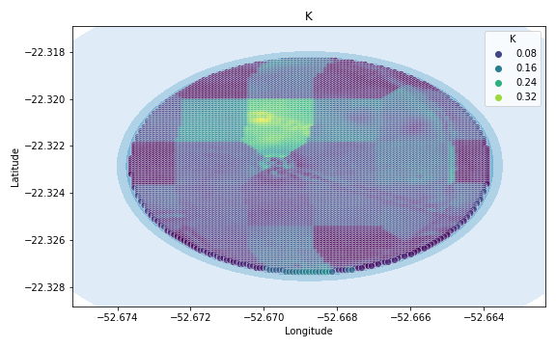
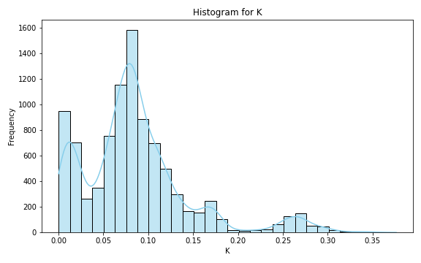
Analysis for column: K Model: Linear Regression
Statistics:
mean 0.085803
std 0.061080
min 0.000025
25% 0.052067
50% 0.079180
75% 0.107303
80% 0.115744
85% 0.130047
90% 0.160985
95% 0.240973
99% 0.285121

Slide 4
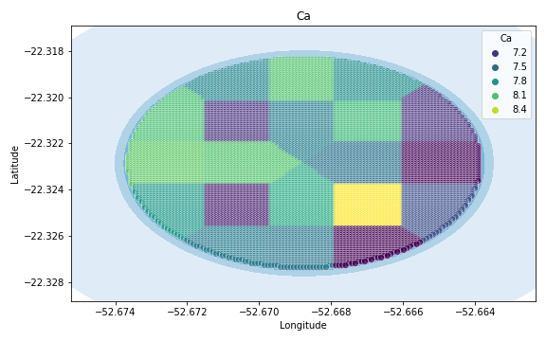
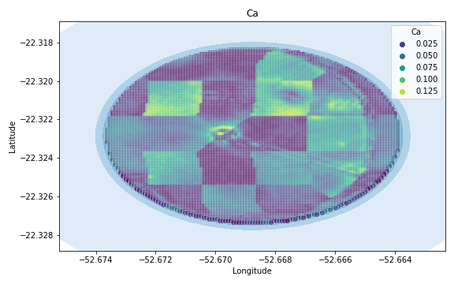
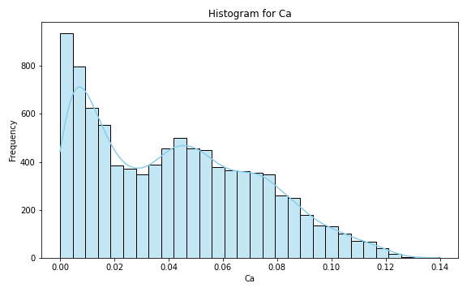
Analysis for column: Ca Model: Linear Regression
Statistics:
mean 0.042134
std 0.030605
min 0.000005
25% 0.013757
50% 0.040010
75% 0.065210
80% 0.071284
85% 0.077464
90% 0.085361
95% 0.096659
99% 0.114491

Slide 5
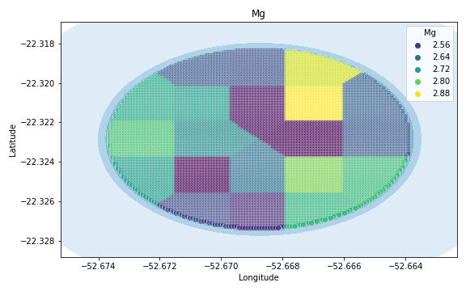
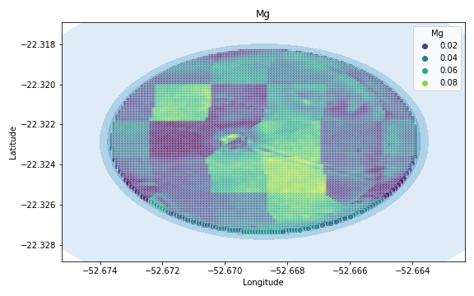
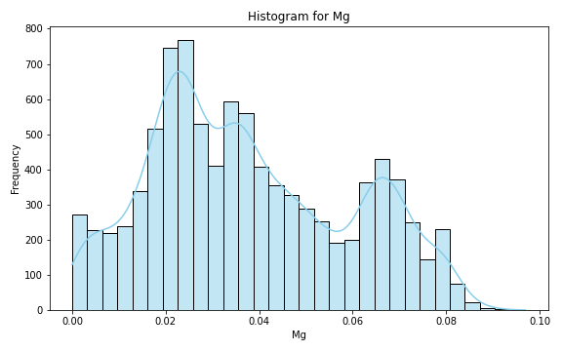
Analysis for column: Mg Model: Linear Regression
Statistics:
mean 0.037891
std 0.021170
min 0.000003
25% 0.021794
50% 0.034594
75% 0.054306
80% 0.061746
85% 0.065542
90% 0.069190
95% 0.074706
99% 0.080997

Slide 6
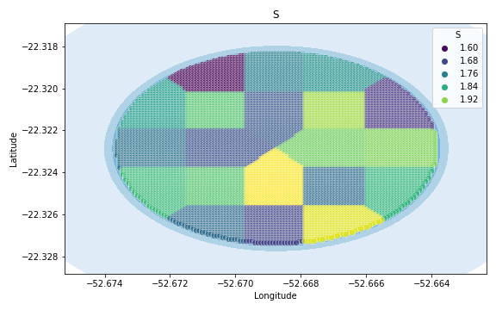
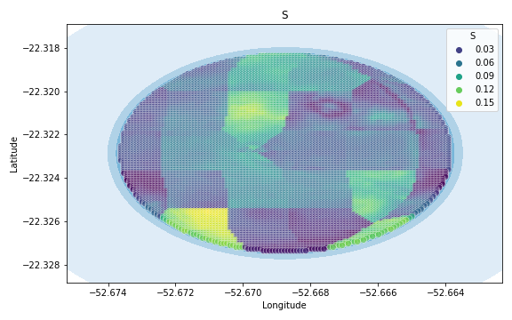
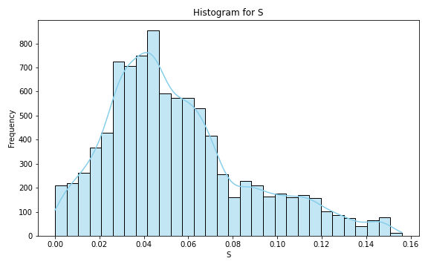
Analysis for column: S Model: Linear Regression
Statistics:
mean 0.054910
std 0.032059
min 0.000025
25% 0.032126
50% 0.047818
75% 0.070147
80% 0.078421
85% 0.090555
90% 0.104653
95% 0.119256
99% 0.145454

Slide 7
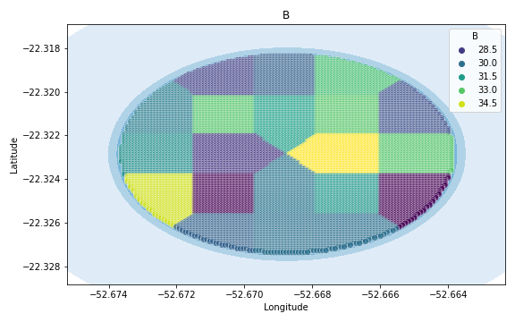
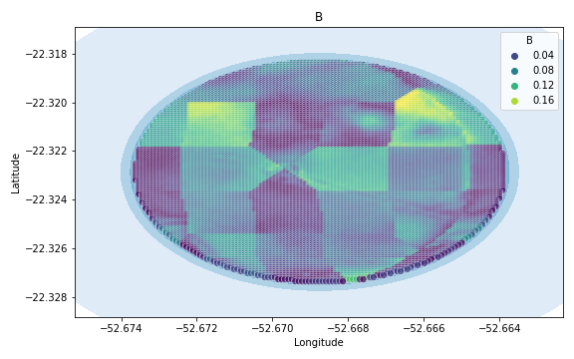
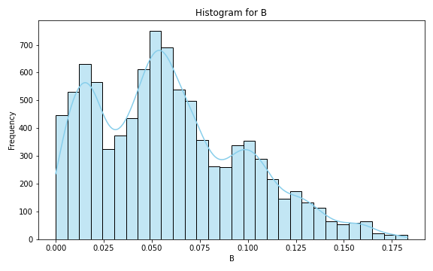
Analysis for column: B Model: Linear Regression
Statistics:
mean 0.059546
std 0.038714
min 0.000003
25% 0.027670
50% 0.054905
75% 0.084961
80% 0.094890
85% 0.103252
90% 0.113651
95% 0.131263
99% 0.160931

Slide 8
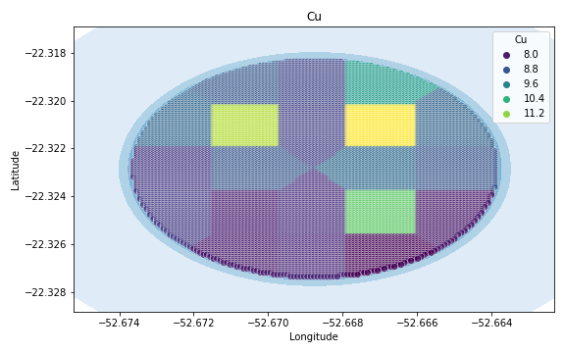
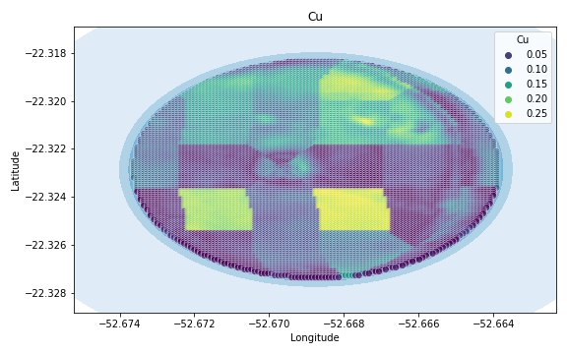
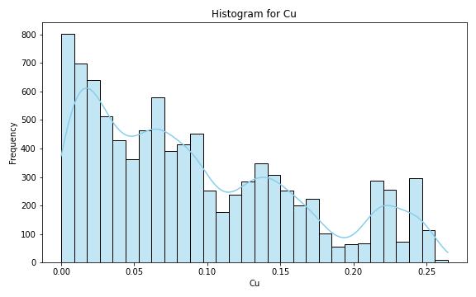
Analysis for column: Cu Model: Linear Regression
Statistics:
mean 0.091316
std 0.071159
min 0.000009
25% 0.029598
50% 0.074484
75% 0.139796
80% 0.153603
85% 0.172570
90% 0.215447
95% 0.232193
99% 0.248060

Slide 9
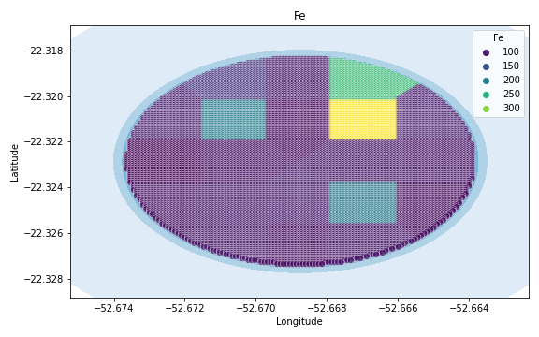
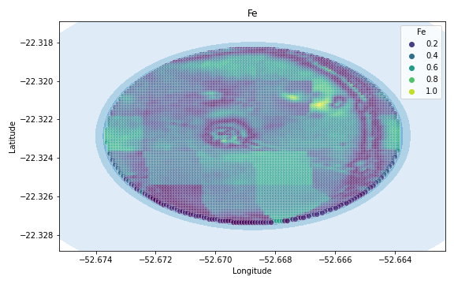
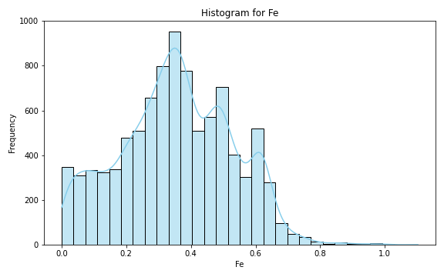
Analysis for column: Fe Model: Linear Regression
Statistics:
mean 0.354368
std 0.174096
min 0.000255
25% 0.236138
50% 0.354087
75% 0.482986
80% 0.505219
85% 0.543071
90% 0.599482
95% 0.627167
99% 0.718369

Slide 10
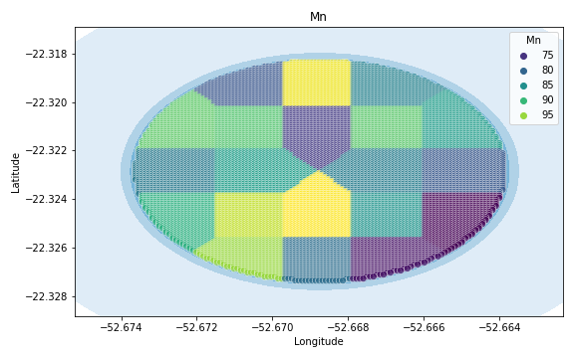
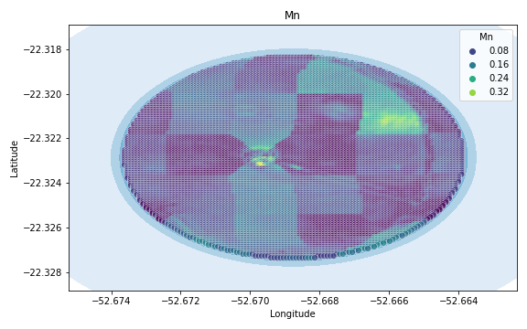
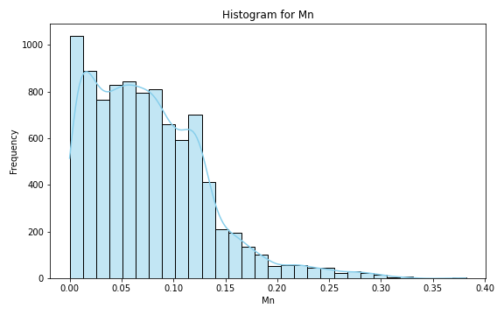
Analysis for column: Mn Model: Linear Regression
Statistics:
mean 0.076443
std 0.056273
min 0.000003
25% 0.032182
50% 0.068350
75% 0.110300
80% 0.119157
85% 0.127663
90% 0.144152
95% 0.178899
99% 0.263535

Slide 11
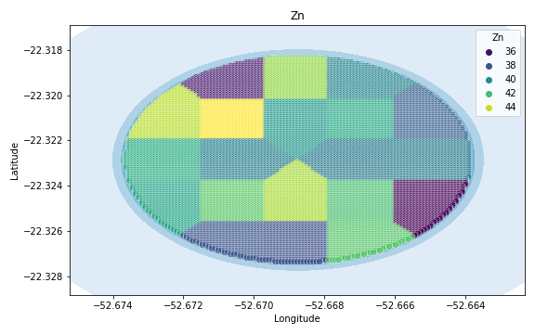
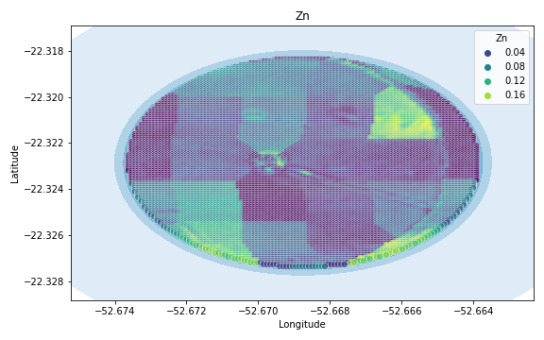
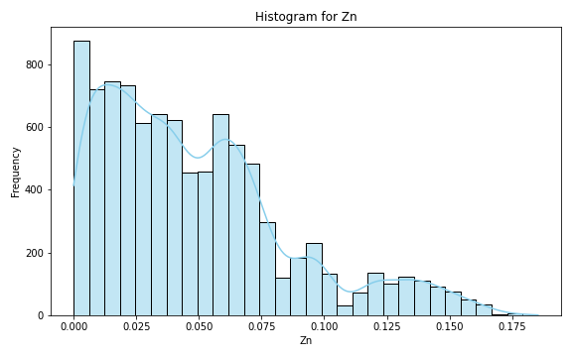
Analysis for column: Zn Model: Linear Regression
Statistics:
mean 0.048401
std 0.037729
min 0.000008
25% 0.018492
50% 0.040364
75% 0.067476
80% 0.073290
85% 0.086417
90% 0.100035
95% 0.132036
99% 0.155179

Slide 12
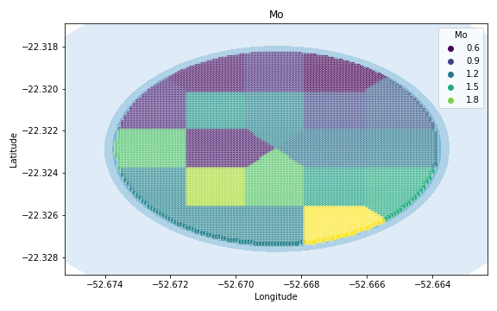
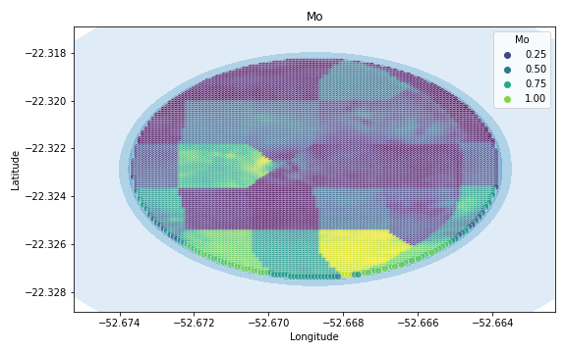
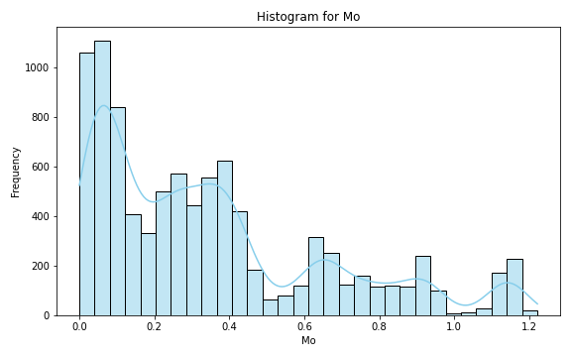
Analysis for column: Mo Model: Linear Regression
Statistics:
mean 0.350332
std 0.311016
min 0.000029
25% 0.087725
50% 0.276107
75% 0.467930
80% 0.638679
85% 0.711410
90% 0.855068
95% 1.006992
99% 1.160399

Slide 13
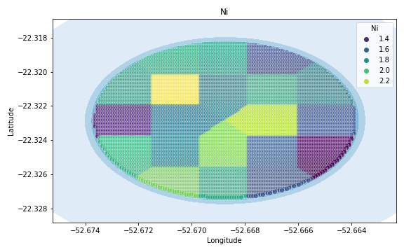
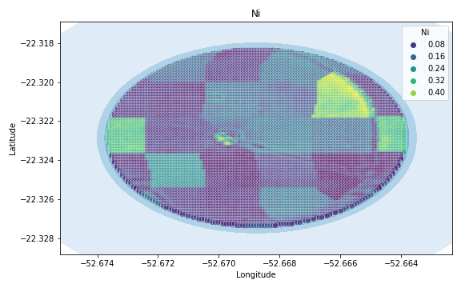
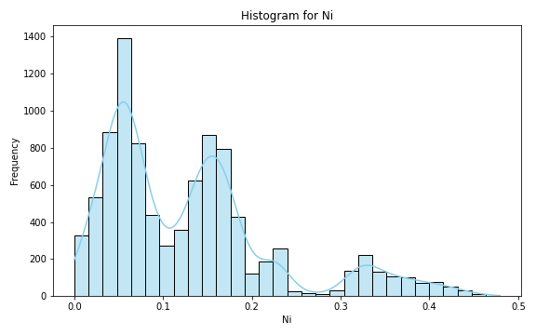
Analysis for column: Ni Model: Linear Regression
Statistics:
mean 0.129556
std 0.097532
min 0.000056
25% 0.054773
50% 0.111516
75% 0.168964
80% 0.179742
85% 0.216494
90% 0.305370
95% 0.348945
99% 0.414790

Slide 14
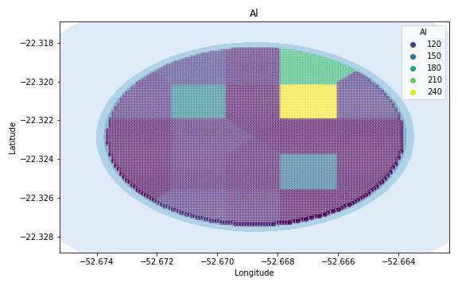
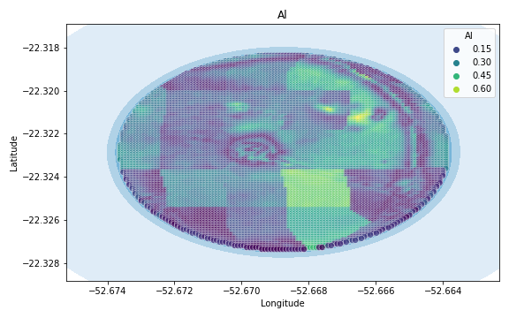
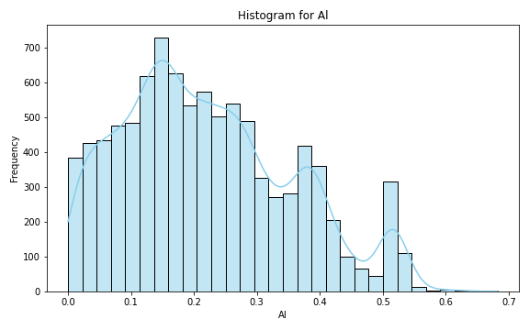
Analysis for column: Al Model: Linear Regression
Statistics:
mean 0.220667
std 0.134171
min 0.000218
25% 0.119439
50% 0.203448
75% 0.309493
80% 0.345671
85% 0.378068
90% 0.403568
95% 0.495080
99% 0.527367

Slide 15
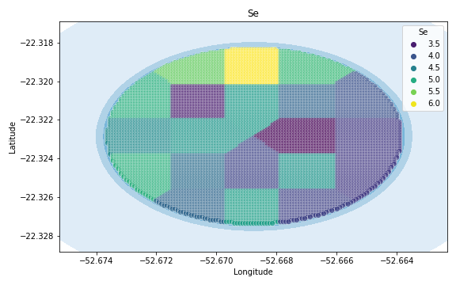
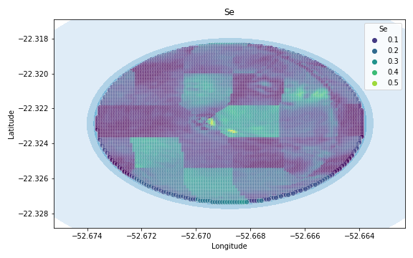
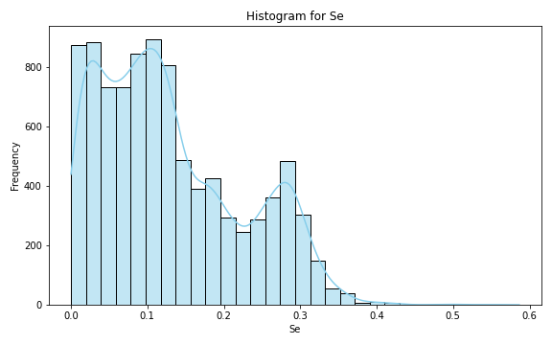
Analysis for column: Se Model: Linear Regression
Statistics:
mean 0.130293
std 0.093401
min 0.000038
25% 0.054929
50% 0.110964
75% 0.191992
80% 0.222433
85% 0.255538
90% 0.279734
95% 0.299475
99% 0.344356

Slide 16
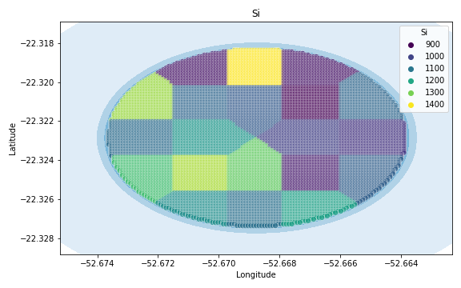
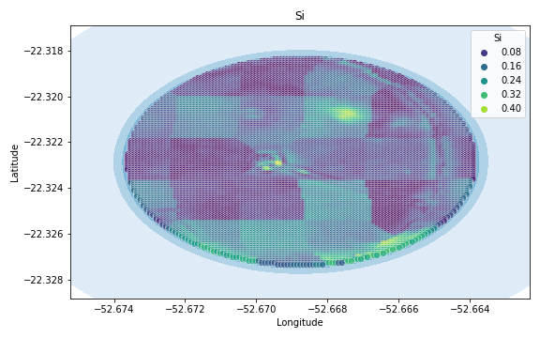
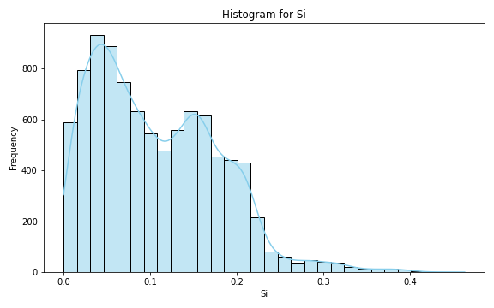
Analysis for column: Si Model: Linear Regression
Statistics:
mean 0.107348
std 0.072577
min 0.000020
25% 0.046543
50% 0.094750
75% 0.158840
80% 0.171348
85% 0.187456
90% 0.204205
95% 0.223841
99% 0.317169

Slide 17
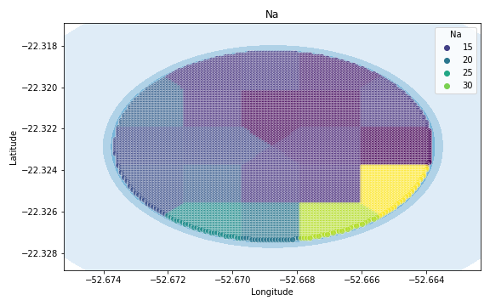
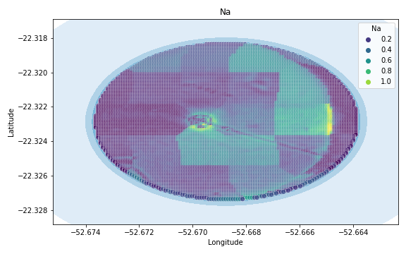

Analysis for column: Na Model: Linear Regression
Statistics:
mean 0.272801
std 0.204121
min 0.000075
25% 0.109333
50% 0.219642
75% 0.450592
80% 0.493309
85% 0.527986
90% 0.558134
95% 0.620552
99% 0.802358

Slide 18



Analysis for column: Va Model: Linear Regression
Statistics:
mean 0.600793
std 0.579249
min 0.000068
25% 0.223267
50% 0.516156
75% 0.685763
80% 0.765510
85% 0.874302
90% 1.160949
95% 1.919410
99% 2.964192

Slide 19



Analysis for column: DRIS_N Model: Linear Regression
Statistics:
mean inf
std NaN
min 0.000073
25% 0.375809
50% 0.681857
75% 3.082305
80% 3.836202
85% 5.535862
90% 6.079954
95% 36.421662
99% NaN

Slide 20



Analysis for column: DRIS_P Model: Linear Regression
Statistics:
mean 0.426440
std 0.792807
min 0.000032
25% 0.085463
50% 0.156094
75% 0.289126
80% 0.376185
85% 0.707699
90% 0.984168
95% 1.579893
99% 3.751943

Slide 21



Analysis for column: DRIS_K Model: Linear Regression
Statistics:
mean 2.316795
std 5.646033
min 0.000013
25% 0.455035
50% 0.658879
75% 1.575793
80% 2.205532
85% 2.687404
90% 3.498713
95% 10.115767
99% 33.169981

Slide 22



Analysis for column: DRIS_Ca Model: Linear Regression
Statistics:
mean 1.787411
std 4.333850
min 0.000075
25% 0.217575
50% 0.540923
75% 1.245376
80% 1.812588
85% 2.312556
90% 2.730352
95% 10.357112
99% 22.482198

Slide 23



Analysis for column: DRIS_Mg Model: Linear Regression
Statistics:
mean 1.652816
std 3.585493
min 0.000099
25% 0.218892
50% 0.431518
75% 0.776268
80% 1.098077
85% 1.396721
90% 4.337929
95% 10.901417
99% 16.924415

Slide 24



Analysis for column: DRIS_S Model: Linear Regression
Statistics:
mean 0.905278
std 2.562836
min 0.000164
25% 0.121559
50% 0.351489
75% 0.558926
80% 0.604947
85% 0.714175
90% 0.824108
95% 1.201413
99% 13.140144

Slide 25



Analysis for column: DRIS_B Model: Linear Regression
Statistics:
mean 1.658647
std 4.236361
min 0.000043
25% 0.206714
50% 0.342054
75% 1.162367
80% 1.581411
85% 1.760414
90% 2.612486
95% 15.674548
99% 20.677964

Slide 26



Analysis for column: DRIS_Cu Model: Linear Regression
Statistics:
mean 0.455349
std 1.491364
min 0.000022
25% 0.055073
50% 0.139465
75% 0.203019
80% 0.219290
85% 0.247080
90% 0.284981
95% 0.437739
99% 7.509642

Slide 27



Analysis for column: DRIS_Fe Model: Linear Regression
Statistics:
mean 1.172880
std 0.852020
min 0.000419
25% 0.611883
50% 0.938472
75% 1.594397
80% 1.761926
85% 1.891591
90% 2.063090
95% 2.747597
99% 4.491122

Slide 28



Analysis for column: DRIS_Mn Model: Linear Regression
Statistics:
mean 0.292627
std 0.542190
min 0.000013
25% 0.074872
50% 0.162021
75% 0.303063
80% 0.318544
85% 0.337002
90% 0.369311
95% 0.559289
99% 2.877704

Slide 29



Analysis for column: DRIS_Zn Model: Linear Regression
Statistics:
mean 0.803988
std 1.636145
min 0.000038
25% 0.163756
50% 0.341227
75% 0.503527
80% 0.594188
85% 0.869966
90% 1.285329
95% 3.275984
99% 8.367080

Slide 30



Analysis for column: IMS Model: Linear Regression
Statistics:
mean 1.271502
std 2.917595
min 0.000029
25% 0.100699
50% 0.209419
75% 0.556392
80% 0.786350
85% 2.888270
90% 3.566821
95% 4.807374
99% 13.851874

Slide 31



Analysis for column: IBN Model: Linear Regression
Statistics:
mean 0.538299
std 1.851653
min 0.000083
25% 0.068923
50% 0.120981
75% 0.220585
80% 0.243229
85% 0.273309
90% 0.318284
95% 0.432578
99% 9.497259

